Slide 1
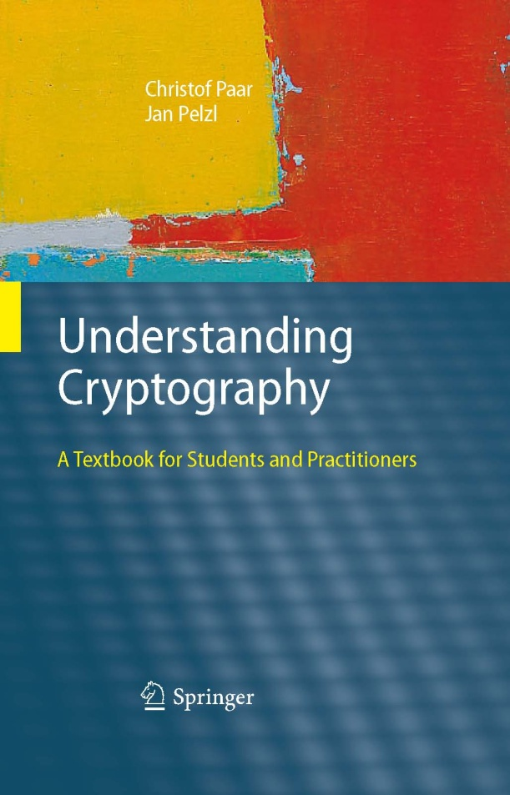
Chapter 10 – Digital Signatures

Slide 2
Content of this Chapter
The principle of digital signatures
Security services
The RSA digital signature scheme
The Elgamal digital signature scheme
The Digital Signature Algorithm (DSA)
The Elliptic Curve Digital Signature Algorithm(ECDSA)

Slide 3
Content of this Chapter
The principle of digital signatures
Security services
The RSA digital signature scheme
The Elgamal digital signature scheme
The Digital Signature Algorithm (DSA)
The Elliptic Curve Digital Signature Algorithm(ECDSA)

Slide 4
Motivation
Alice orders a pink car from the car salesmen Bob
After seeing the pink car, Alice states that she has never ordered it:
How can Bob prove towards a judge that Alice has ordered a pink car? (And that he did not fabricate the order himself)
Symmetric cryptography fails because both Alice and Bob can be malicious
Can be achieved with public-key cryptography

Slide 5
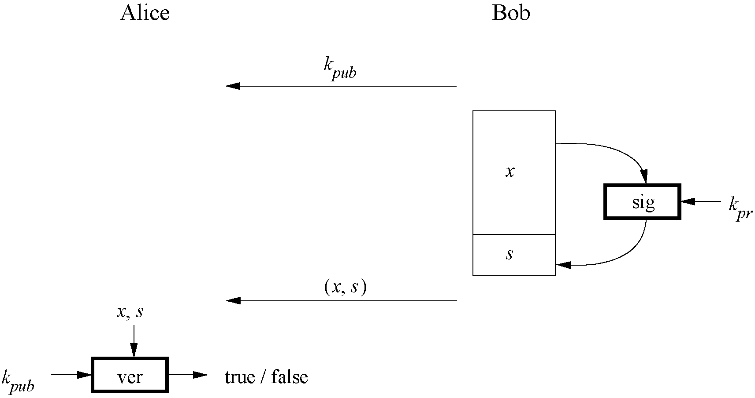
Basic Principle of Digital Signatures

Slide 6
Main idea
For a given message x, a digital signature is appended to the message (just like a conventional signature).
Only the person with the private key should be able to generate the signature.
The signature must change for every document.
The signature is realized as a function with the message x and the private key as input.
The public key and the message x are the inputs to the verification function.

Slide 7
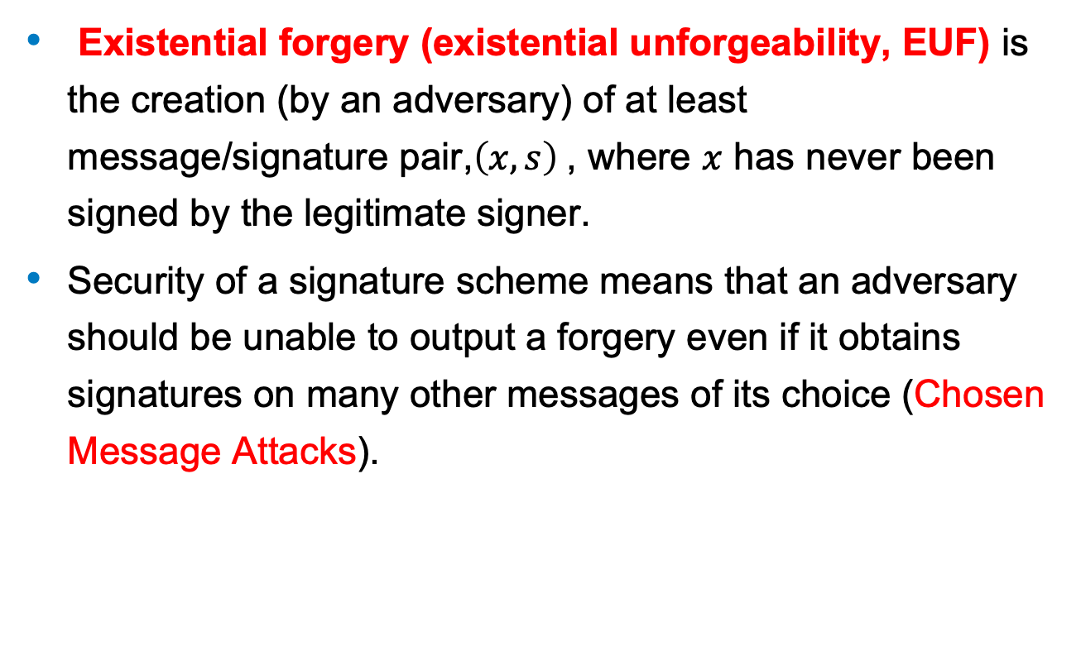
Security of Signature Schemes
Existential forgery (existential unforgeability, EUF) is the creation (by an adversary) of at least message/signature pair,$\left(x,s\right)$, where $x$ has never been signed by the legitimate signer.
Security of a signature scheme means that an adversary should be unable to output a forgery even if it obtains signatures on many other messages of its choice (Chosen Message Attacks).

Slide 8
Content of this Chapter
The principle of digital signatures
Security services
The RSA digital signature scheme
The Elgamal digital signature scheme
The Digital Signature Algorithm (DSA)
The Elliptic Curve Digital Signature Algorithm(ECDSA)

Slide 9
Core Security Services
The objectives of a security systems are called security services.
Confidentiality: Information is kept secret from all but authorized parties.
Integrity: Ensures that a message has not been modified in transit.
Message Authentication: Ensures that the sender of a message is authentic. An alternative term is data origin authentication.
Non-repudiation: Ensures that the sender of a message can not deny the creation of the message. (c.f. order of a pink car)

Slide 10
Additional Security Services
Identification/entity authentication: Establishing and verification of the identity of an entity, e.g. a person, a computer, or a credit card.
Access control: Restricting access to the resources to privileged entities.
Availability: The electronic system is reliably available.
Auditing: Provides evidences about security relevant activities, e.g., by keeping logs about certain events.
Physical security: Providing protection against physical tampering and/or responses to physical tampering attempts
Anonymity: Providing protection against discovery and misuse of identity.

Slide 11
Content of this Chapter
The principle of digital signatures
Security services
The RSA digital signature scheme
The Elgamal digital signature scheme
The Digital Signature Algorithm (DSA)
The Elliptic Curve Digital Signature Algorithm(ECDSA)

Slide 12
Main idea of the schoolbook RSA signature scheme
To generate the private and public key:
Use the same key generation as RSA encryption.
To generate the signature:
“encrypt” the message x with the private key
Append s to message x
To verify the signature:
“decrypt” the signature with the public key
If x‘=x, the signature is valid
s = sig_{Kpriv}(x) = x^{d} mod n
x=ver_{Kpub}(s)=s^{e} mod n

Slide 13
The Schoolbook RSA Signature Protocol
Alice
Bob
K_{pub}
K_{pr} = d
K_{pub} = (n, e)
Compute signature:
s = sig_{kpr}(x) ≡ x^{d} mod n
(x,s)
Verify signature:
x’ ≡ s^{e} mod n
If x’ ≡ x mod n → valid signature
If x’ ≡ x mod n → invalid signature

Slide 14
Security and Performance of the RSA Signature Scheme
Security:
The same constrains as RSA encryption: n needs to be at least 1024 bits to provide a security level of 80 bit.
The signature, consisting of s, needs to be at least 1024 bits long.
Performance:
The signing process is an exponentiation with the private key and the verification process an exponentiation with the public key e.
Signature verification is very efficient as a small number can be chosen for the public key.

Slide 15
Existential Forgery Attack against Schoolbook RSA Digital Signature
Alice
Oscar
Bob
K_{pr} = d
K_{pub} = (n, e)
(n,e)
(n,e)
1. Choose signature:
s Z_{n}
2. Compute message:
x ≡ s^{e} mod n
(x,s)
Verification:
s^{e} ≡ x’ mod n
since s^{e} ≡ x mod n
→ Signature is valid

Slide 16
Existential Forgery and Padding
An attacker can generate valid message-signature pairs (x,s)
But an attack can only choose the signature s and NOT the message x
Attacker cannot generate messages like “Transfer $1000 into Oscar‘s account”
Formatting the message x according to a padding scheme can be used to make sure that an attacker cannot generate valid (x,s) pairs.
(A messages x generated by an attacker during an Existential Forgery Attack will not coincide with the padding scheme. For more details see Chapter 10 in Understanding Cryptography.)

Slide 17
RSA Padding: The Probabilistic Signature Standard (PSS)
The attack above can be prevented by allowing only certain message formats. Roughly speaking, formatting imposes a rule which allows the verifier, Alice in our examples, to distinguish between valid and invalid messages; this is called padding.
For example, a simple formatting rule could specify that all messages x have 100 trailing bits with the value zero (or any other specific bit pattern). If Oscar chooses signature values s and computes the “message” x ≡ s^{e} mod n, it is extremely unlikely that x has this specific format.

Slide 18
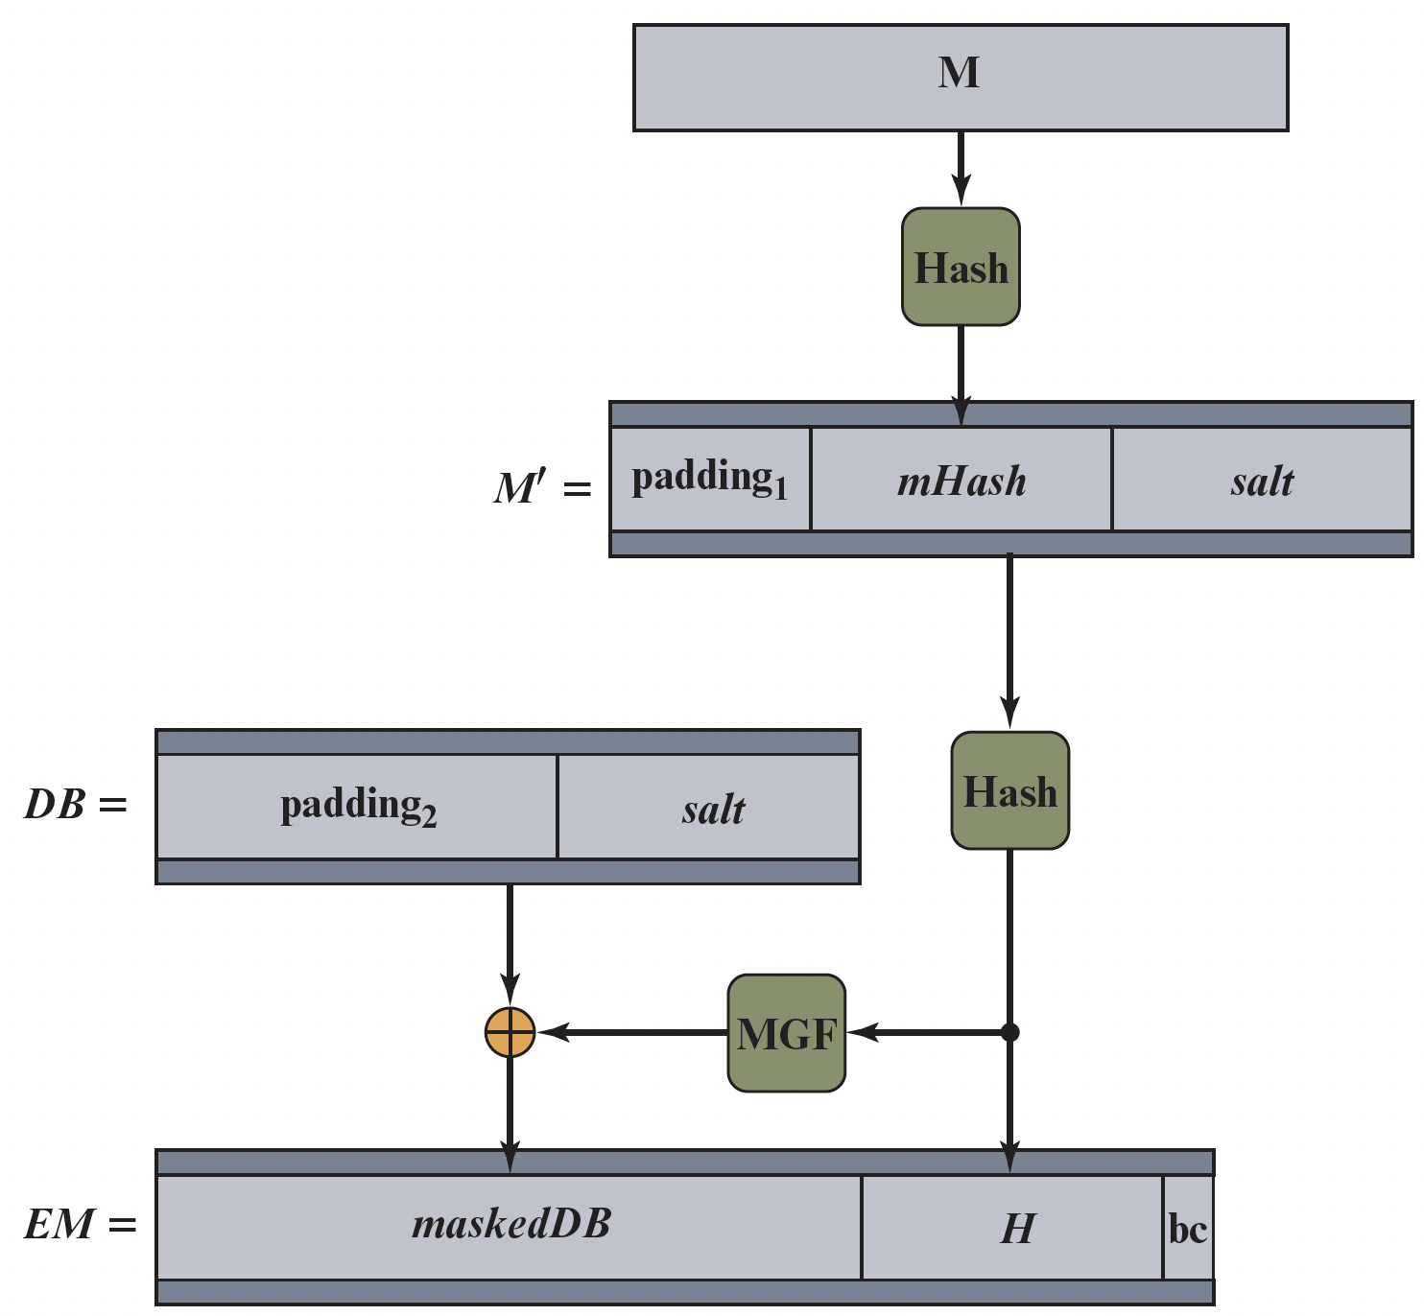
RSA-PSS Encoding

Slide 19
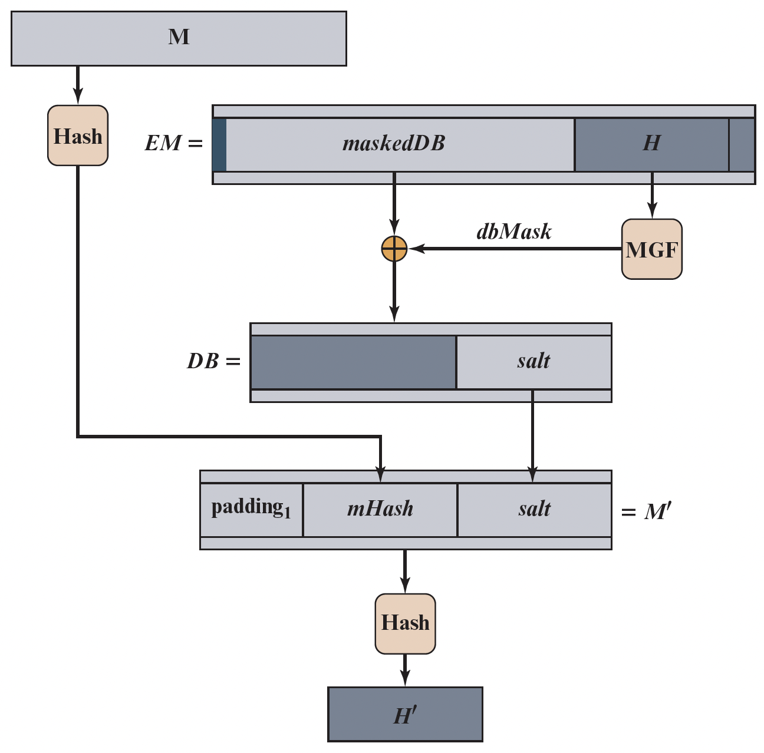
RSA-PSS Verification

Slide 20
Content of this Chapter
The principle of digital signatures
Security services
The RSA digital signature scheme
The Elgamal digital signature scheme
The Digital Signature Algorithm (DSA)
The Elliptic Curve Digital Signature Algorithm(ECDSA)

Slide 21
Facts about the Elgamal Digital Signature Scheme
Published in 1985
Based on the difficulty of computing discrete logarithms
Quite different from the encryption scheme with the same name

Slide 22
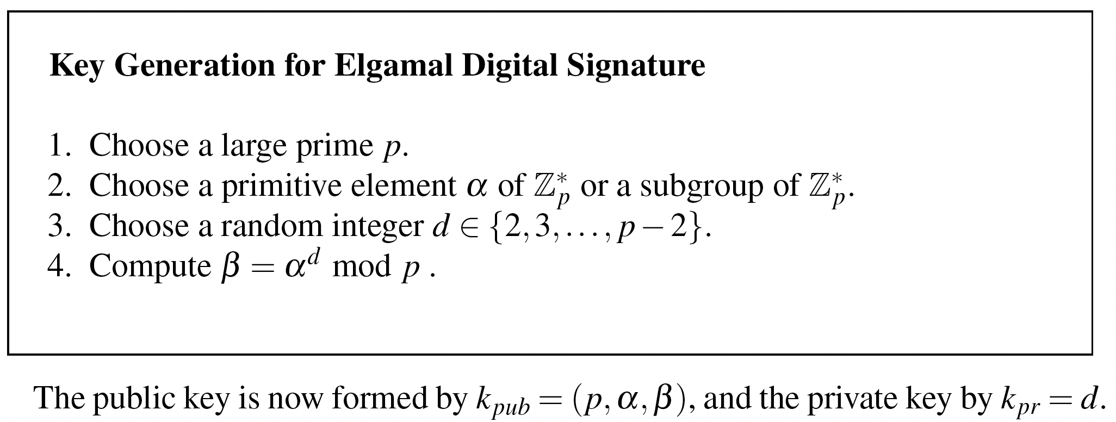
Schoolbook Elgamal Digital Signature

Slide 23
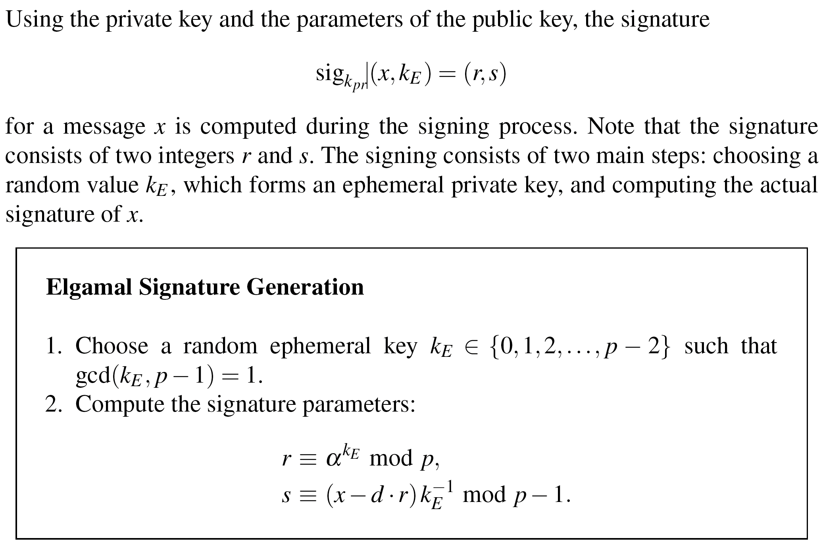
Schoolbook Elgamal Digital Signature

Slide 24
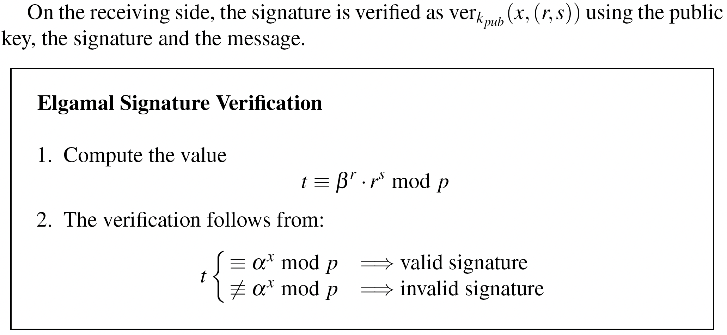
Schoolbook Elgamal Digital Signature

Slide 25
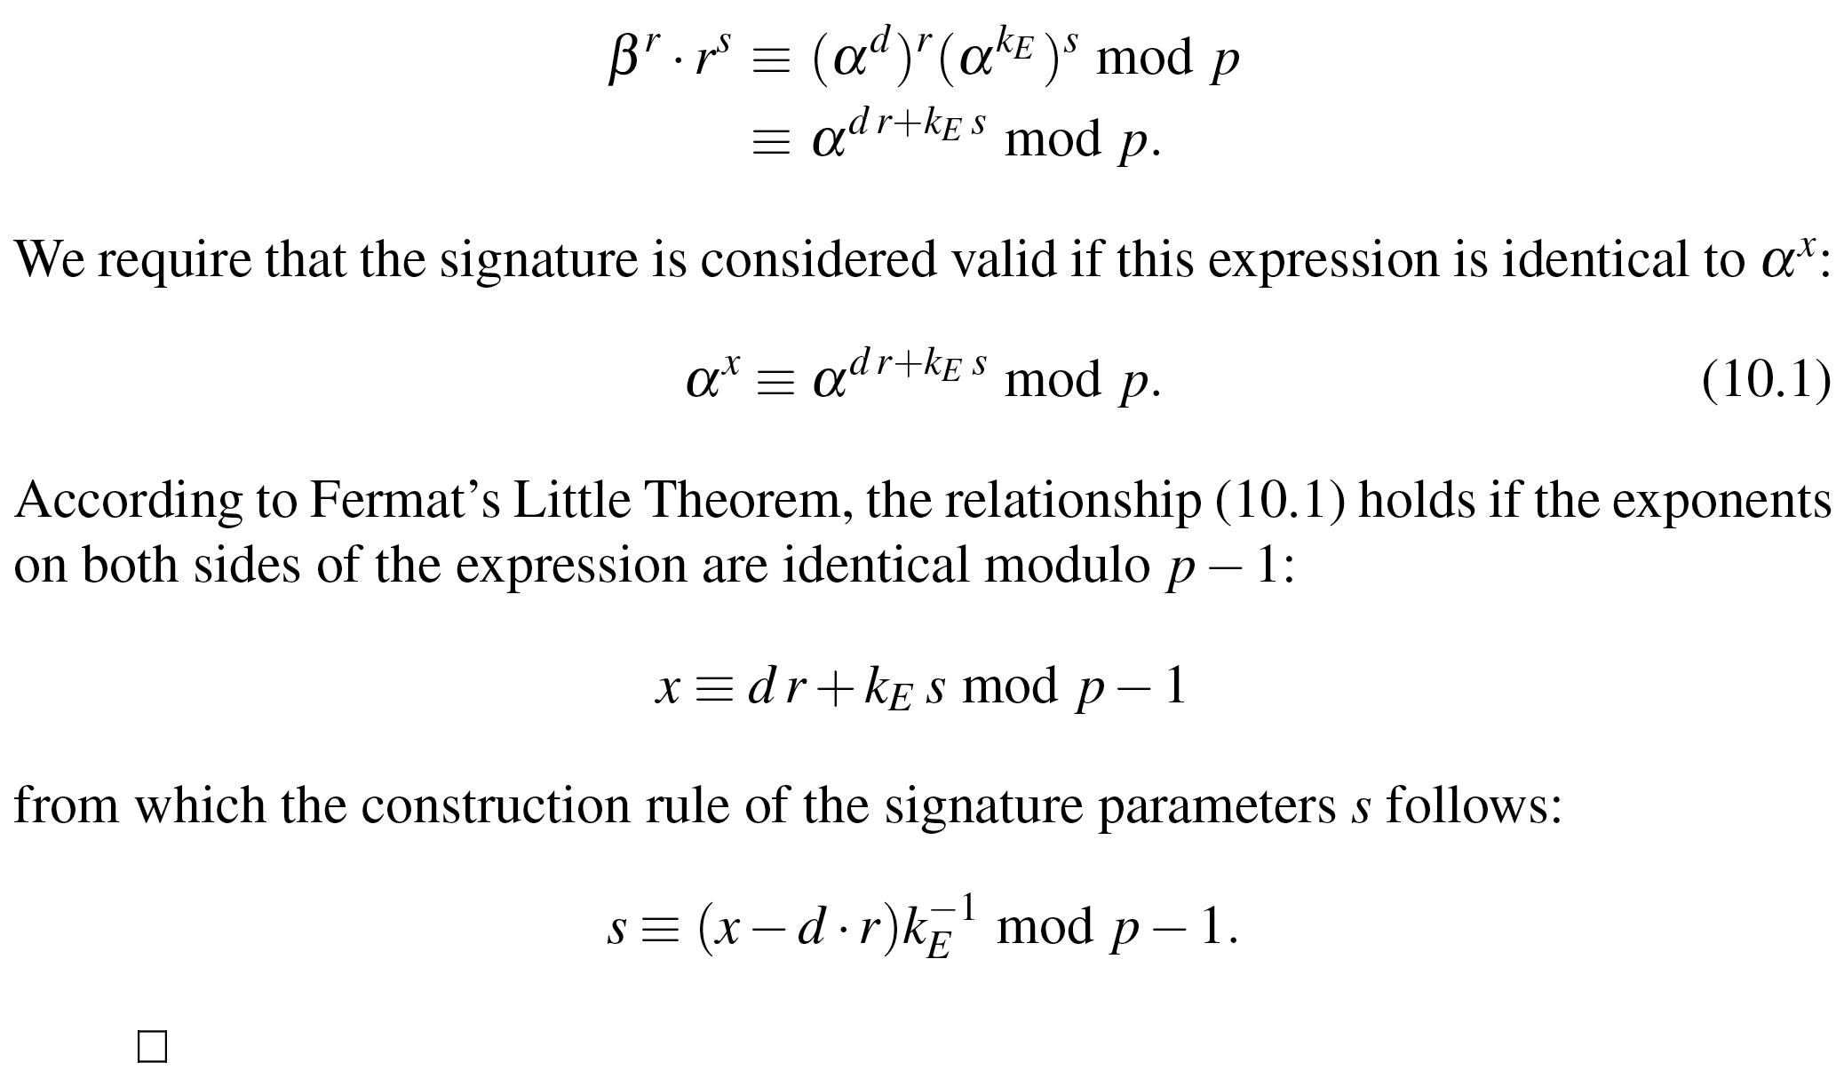

Correctness of the schoolbook Elgamal signature scheme

Slide 26
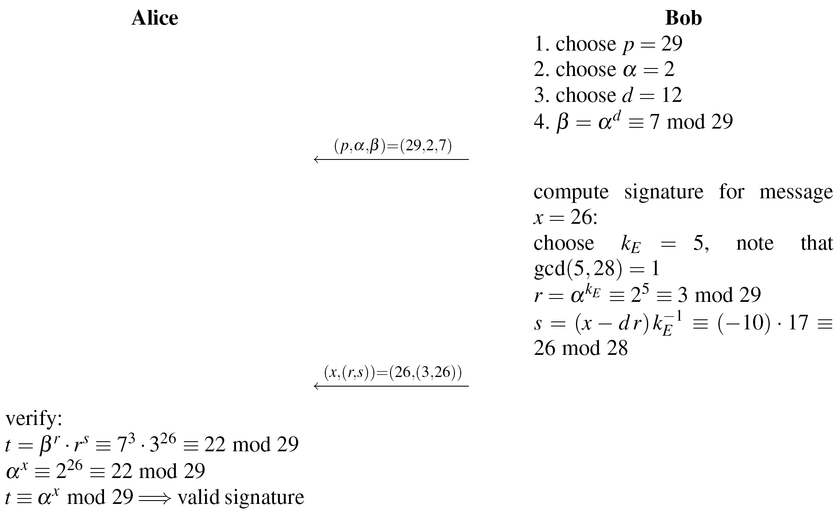
Example of the schoolbook Elgamal signature scheme

Slide 27
Security of the schoolbook Elgamal Digital Signature Scheme
Reuse of the Ephemeral Key
Existential Forgery Attack

Slide 28
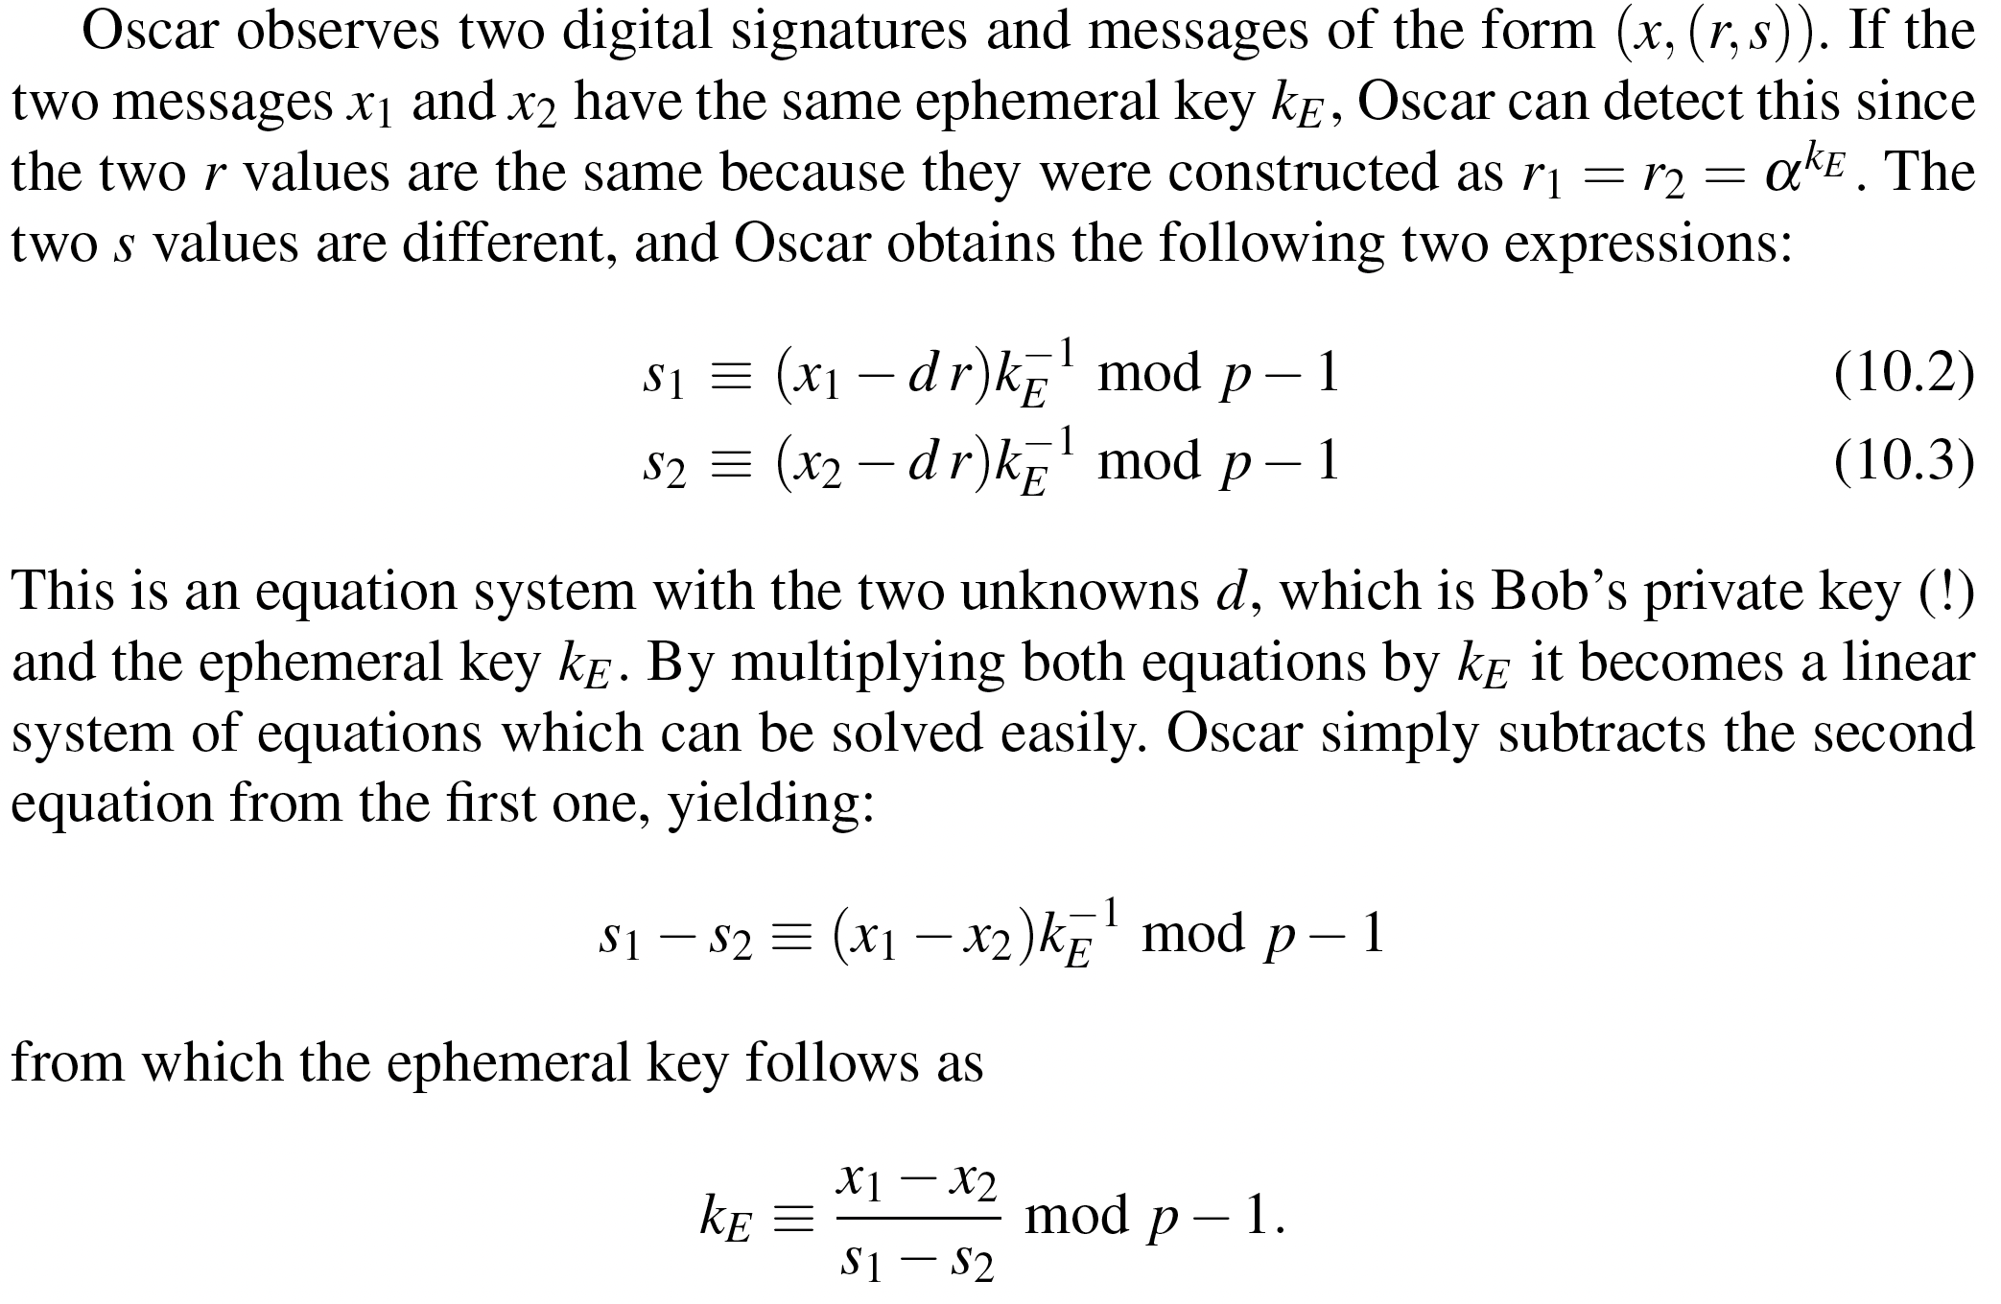
Reuse the Ephemeral Key

Slide 29
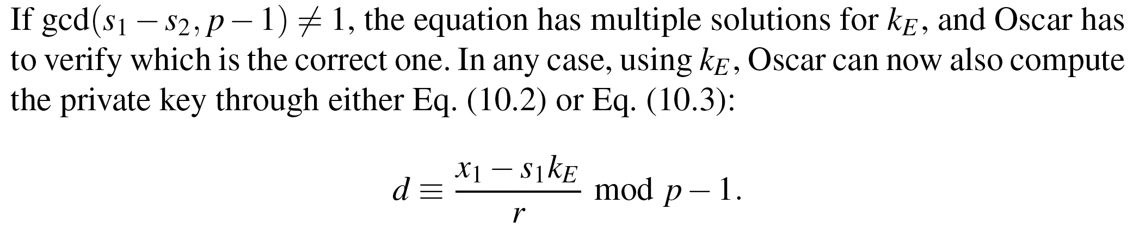
Reuse the Ephemeral Key

Slide 30
Content of this Chapter
The principle of digital signatures
Security services
The RSA digital signature scheme
The Elgamal digital signature scheme
The Digital Signature Algorithm (DSA)
The Elliptic Curve Digital Signature Algorithm(ECDSA)

Slide 31
Facts about the Digital Signature Algorithm (DSA)
Federal US Government standard for digital signatures (DSS)
Proposed by the National Institute of Standards and Technology (NIST)
DSA is based on the Elgamal signature scheme
Signature is only 320 bits long
Signature verification is slower compared to RSA

Slide 32
The Digital Signature Algorithm (DSA)
Key generation of DSA:
Generate a prime p with 2¹⁰²³ < p < 2¹⁰²⁴
Find a prime divisor q of p-1 with 2¹⁵⁹ < q < 2¹⁶⁰
Find an integer α with ord(α)=q
Choose a random integer d with 0<d<q
Compute β ≡ α^{d} mod p
The keys are:
k_{pub} = (p,q,α,β)
k_{pr} = (d)

Slide 33
The Digital Signature Algorithm (DSA)
DSA signature generation :
Given: message x, signature s, private key d and public key (p,q,α,β)
Choose an integer as random ephemeral key k_{E} with 0<k_{E}<q
Compute r ≡ (α^{kE} mod p) mod q
Computes s ≡ (H(x)+d ∙ r) k_{E}⁻¹ mod q
The signature consists of (r, s)
H(x) denotes a hash function which computes a 160-bit fingerprint of message x. (See Chapter 11 of Understanding Cryptography for more details)

Slide 34
The Digital Signature Algorithm (DSA)
DSA signature verification
Given: message x, signature s and public key (p,q,α,β)
Compute auxiliary value w ≡ s⁻¹ mod q
Compute auxiliary value u₁ ≡ w ∙ H(x) mod q
Compute auxiliary value u₂ ≡ w ∙ r mod q
Compute v ≡ (α^{u1} ∙ β ^{u2} mod p) mod q
If v ≡ r mod q → signature is valid
If v ≡ r mod q → signature is invalid

Slide 35
Proof of DSA:
We show need to show that the signature (r,s) in fact satisfied the condition r ≡ v mod q:
s ≡ (SHA(x))+d ∙r) ∙ k_{E} ⁻¹ mod q
⬄ k_{E} ≡ s⁻¹ SHA(x) + d ∙ s⁻¹ r mod q
⬄ k_{E} ≡u₁+d ∙ u₂ mod q
We can raise α to either side of the equation if we reduce modulo p:
⬄ α^{kE} mod p ≡ α^{u1+d∙u2} mod p
Since β ≡ α^{d} mod p we can write:
⬄ α^{kE} mod p ≡ α^{u1} β^{u2} mod p
We now reduce both sides of the equation modulo q:
⬄ (α^{kE} mod p) mod q ≡ (α^{u1} β^{u2} mod p) mod q
Since r ≡ α^{kE} mod p mod q and v ≡ (α^{u1} β^{u2} mod p) mod q, this expression is identical to:
⬄ r ≡ v

Slide 36
Example
Alice
Bob
Key generation:
choose p = 59 and q = 29
choose α = 3
choose private key d = 7
β = α^{β} = 3⁷ ≡ 4 mod 59
Sign:
Compute has of message H(x)=26
Choose ephermal key k_{E}=10
r = (3¹⁰ mod 59) ≡ 20 mod 29
s = (26 + 7 ∙ 20) ∙ 3) ≡ 5 mod 29
(p, q, α, β)=(59, 29, 3, 4)
(x,(r, s))=(x,20, 5)
Verify:
w ≡ 5⁻¹ ≡ 6 mod 29
u₁ ≡ 6 ∙ 26 ≡ 11 mod 29
u₂ ≡ 6 ∙ 20 ≡ 4 mod 29
v = (3¹¹ ∙ 4⁴ mod 59) mod 29 = 20
v ≡ r mod 29 → valid signature

Slide 37
Security of DSA
To solve the discrete logarithm problem in p the powerful index calculus method can be applied. But this method cannot be applied to the discrete logarithm problem of the subgroup q. Therefore q can be smaller than p. For details see Chapter 10 and Chapter 8 of Understanding Cryptography .
p | q | hash output (min) | security levels
1024 | 160 | 160 | 80
2048 | 224 | 224 | 112
3072 | 256 | 256 | 128
Standardized parameter bit lengths and security levels for the DSA

Slide 38
Content of this Chapter
The principle of digital signatures
Security services
The RSA digital signature scheme
The Elgamal digital signature scheme
The Digital Signature Algorithm (DSA)
The Elliptic Curve Digital Signature Algorithm(ECDSA)

Slide 39
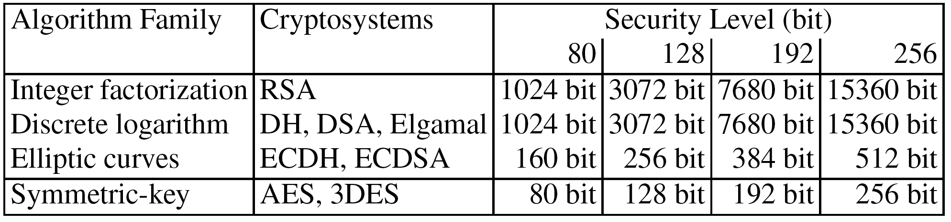
Bit lengths of Public-key Algorithms

Slide 40
Elliptic Curve Digital Signature Algorithm (ECDSA)
Based on Elliptic Curve Cryptography (ECC)
Bit lengths in the range of 160-256 bits can be chosen to provide security equivalent to 1024-3072 bit RSA (80-128 bit symmetric security level)
One signature consists of two points, hence the signature is twice the used bit length (i.e., 320-512 bits for 80-128 bit security level).
The shorter bit length of ECDSA often result in shorter processing time.

Slide 41
Elliptic Curve Digital Signature Algorithm (ECDSA)
Based on Elliptic Curve Cryptography (ECC)
Bit lengths in the range of 160-256 bits can be chosen to provide security equivalent to 1024-3072 bit RSA (80-128 bit symmetric security level)
One signature consists of two points, hence the signature is twice the used bit length (i.e., 320-512 bits for 80-128 bit security level).
The shorter bit length of ECDSA often result in shorter processing time.

Slide 42
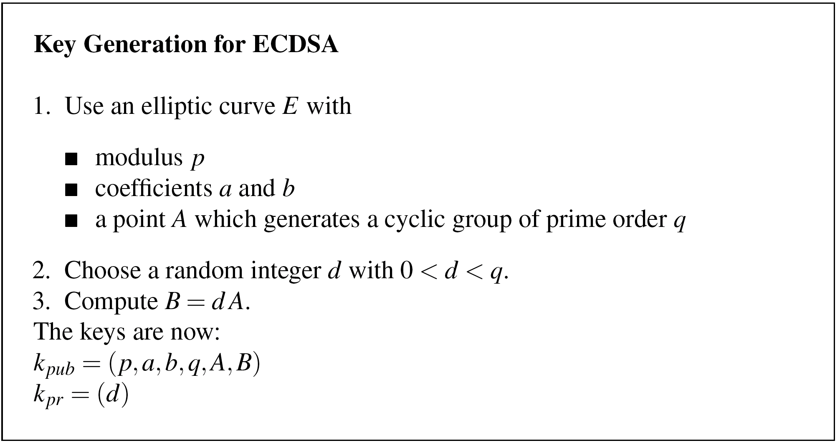
Key Generation

Slide 43
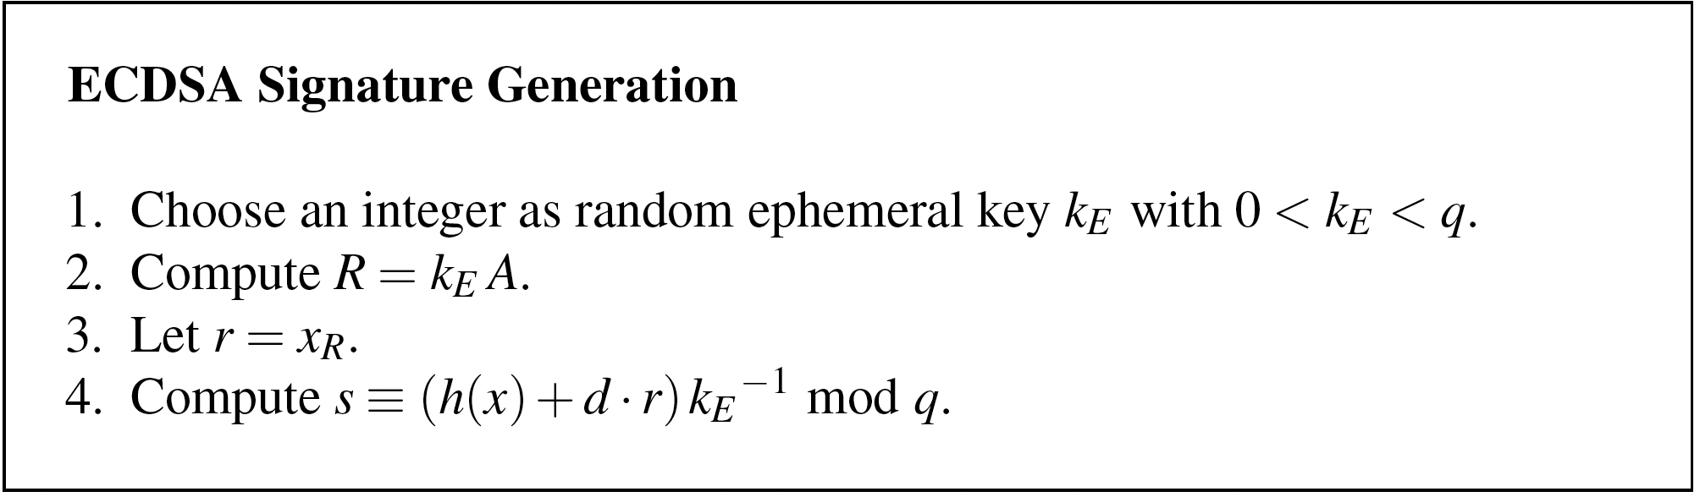
Signature Generation

Slide 44
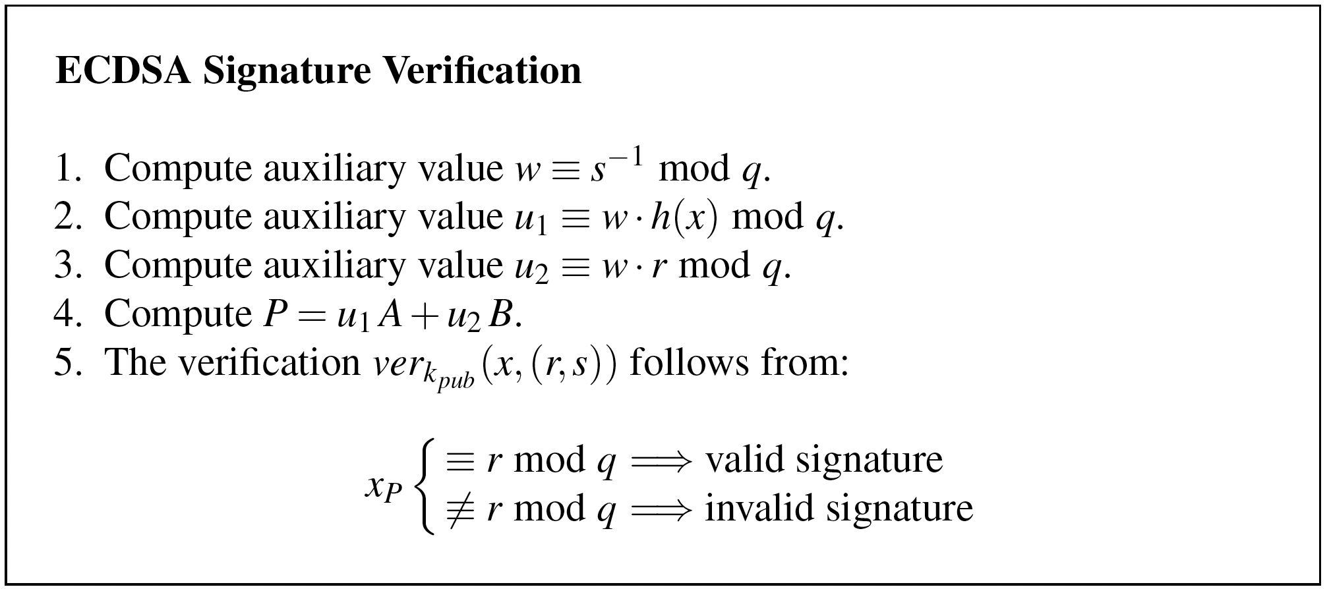
Signature Verification

Slide 45
Lessons Learned
Digital signatures provide message integrity, message authentication and non-repudiation.
RSA is currently the most widely used digital signature algorithm.
Competitors are the Digital Signature Standard (DSA) and the Elliptic Curve Digital Signature Standard (ECDSA).
RSA verification can be done with short public keys e. Hence, in practice, RSA verification is usually faster than signing.
DSA and ECDSA have shorter signatures than RSA
In order to prevent certain attacks, RSA should be used with padding.
The modulus of DSA and the RSA signature schemes should be at least 1024- bits long. For true long-term security, a modulus of length 3072 bits should be chosen. In contrast, ECDSA achieves the same security levels with bit lengths in the range 160–256 bits.

Slide 46
中国商用密码算法SM2椭圆曲线公钥密码签名算法
SM2椭圆曲线公钥密码加密算法见4.8节，本节介绍SM2椭圆曲线公钥密码的数字签名算法。
1 基本参数
与SM2椭圆曲线公钥密码加密算法的参数设置相同。
2 密钥产生
设签名方是A，A的秘密钥/公开钥的产生方式与SM2椭圆曲线公钥密码加密算法接收方B的产生方式相同，分别记为 和 。

Slide 47
设 是A的长度为 比特的标识， 是由
转换而成的两个字节，A计算
，其中a,b是椭圆曲线方程的参数、 是基点G的坐标， 是 的坐标。这些值转换为比特串后，再用H_{256。}验证 B验证签名时，也需计算Z_{A。}

Slide 48
3 签名算法
设待签名的消息为M，A做以下运算：
①取 ；
②计算 ，将 转换为整数， 是输出为比特长的哈希函数；
③用随机数发生器产生随机数 ；
④计算椭圆曲线点 ；
⑤计算 ，若r=0或 则返
回③；
⑥计算 ，若s=0则返回③；
⑦消息M的签名为 。

Slide 49
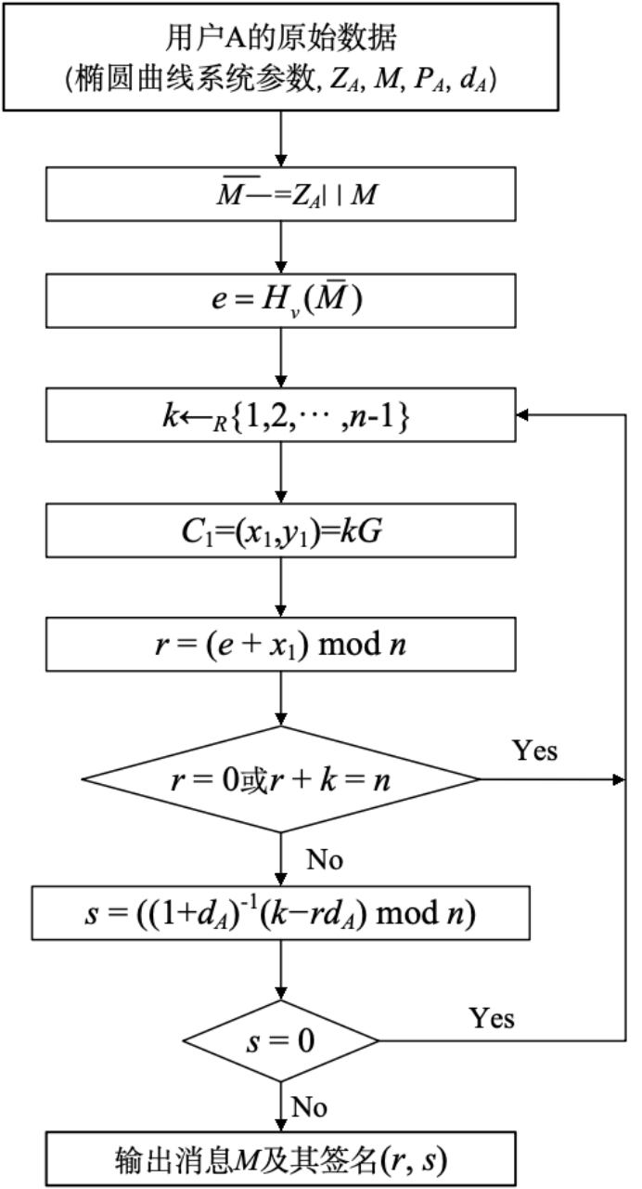
图 SM2签名算法流程图

Slide 50
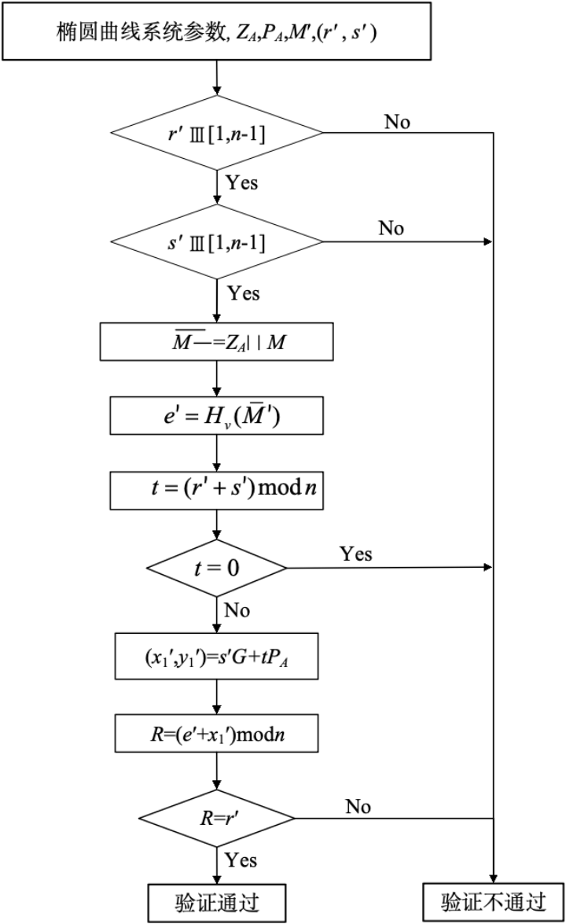
图 SM2签名验证算法流程图

Slide 51
第七章 数字签名和认证协议
4 验证算法
B收到消息 及其签名 后，执行以下验证运算：
①检验 是否成立，若不成立则验证不通过；
②检验 是否成立，若不成立则验证不通过；
③置 ；
④计算 ，将 转换为整数；
⑤计算 ，若t=0；则验证不通过；
⑥计算椭圆曲线点 ；
⑦计算 ，检验 是否成立，若成立则验证通过；否则验证不通过。

Slide 52
第七章 数字签名和认证协议
正确性：如果 ，则 ，要证
, 只需证 。

